Slide 1
Instruction pipeline
Presented by:
Zahid ali

Slide 2
Instruction Pipelining
pipelining is the process of arrangement of hardware elements of CPU such that its over all performance can be increased.
new inputs are accepted at one end before previously accepted inputs appear as outputs at the other end
Not implementing new hardware but rearranging the existing hardware components
simultaneous execution of more than one instructions take place in pipelined processor.
multiple instructions are overlapped during execution.

Slide 3
Decomposition of instructions/Stages
Fetch instruction (FI): Read the next expected instruction into a buffer.
Decode instruction (DI): Determine the opcode and the operand specifiers.
Calculate operands (CO): Calculate the effective address of each source operand.

Slide 4
Decomposition of instructions/Stages
Fetch operands (FO): Fetch each operand from memory
Execute instruction (EI): Perform the indicated operation and store the result in the specified destination operand location.
Write operand (WO): Store the result in memory

Slide 5
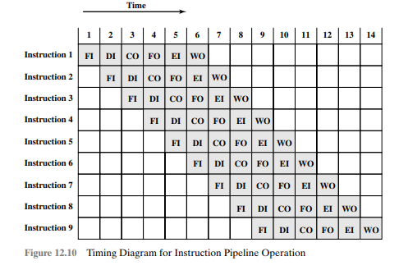
diagram for instruction pipeline operation

Slide 6
Pipelined vs non pipelined
Performance for pipeline
INSTRUCTIONS | 1 | 2 | 3 | 4 | 5 | 6
INSTRUCTION 1 | FI | DI | CO | FO | EI | WO
INSTRUCTION 2 | FI | DI | CO | FO | EI | WO
INSTRUCTION 3 | FI | DI | CO | FO | EI | WO
INSTRUCTION 4 | FI | DI | CO | FO | EI | WO
INSTRUCTION 5 | FI | DI | CO | FO | EI | WO
INSTRUCTION 6 | FI | DI | CO | FO | EI | WO
INSTRUCTION 7 | FI | DI | CO | FO | EI | WO
INSTRUCTION 8 | FI | DI | CO | FO | EI | WO
INSTRUCTION 9 | FI | DI | CO | FO | EI | WO
SPEED UP=K+(N-1)t SPEED UP=N*Kt
=6+(9-1) SPEED UP=9*6
=14 SPEED UP=54

Slide 7
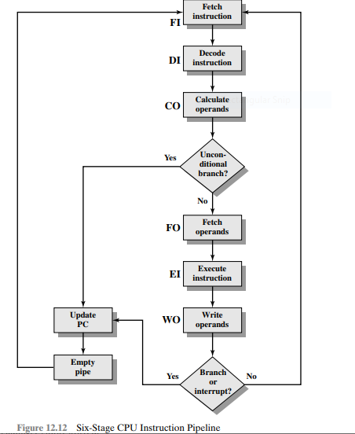
Six stage cpu instruction pipeline

Slide 8
Pipeline hazards
Problems in pipelining
A pipeline hazard occurs when the pipeline, or some portion of the pipeline, must stall because conditions do not permit continued execution. Such a pipeline stall is also referred to as a pipeline bubble.

Slide 9
Types of Pipeline hazards
Structural/resource hazard
control hazard
Data hazard

Slide 10
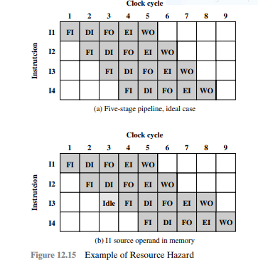
Structural hazard
When two or more than two instructions need same resource

Slide 11
data hazard
data hazard arises when one instruction is dependent on the results of a preceding instruction
Attempt to use data before is ready

Slide 12

data hazard types
Read after write (RAW), or true dependency:
A hazard occurs if the read takes place before the write operation is complete
Write after read (RAW), or anti dependency:
A hazard occurs if the write operation completes before the read operation takes place
Write after write (RAW), or output dependency:
A hazard occurs if the write operations take place in the reverse order of the intended sequence.

Slide 13
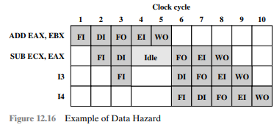
Example:
ADD EAX, EBX /* EAX = EAX + EBX
SUB ECX, EAX /* ECX = ECX - EAX

Slide 14

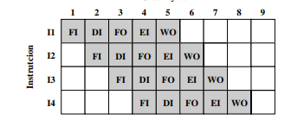
Control hazard
A control hazard, also known as a branch hazard, occurs when the pipeline makes the wrong decision on a branch prediction
branch
stall

